Slide 1
Generative AI Design Patterns
Lecturer: Ngo Huy Bien
Software Engineering Department
Faculty of Information Technology
VNUHCM - University of Science
Ho Chi Minh City, Vietnam
nhbien@fit.hcmus.edu.vn

Slide 2

Objectives

Slide 3

Contents
Valliappa Lakshmanan and Hannes Hapke (2025). Generative AI Design Patterns. O'Reilly.

Slide 4

References

Slide 5
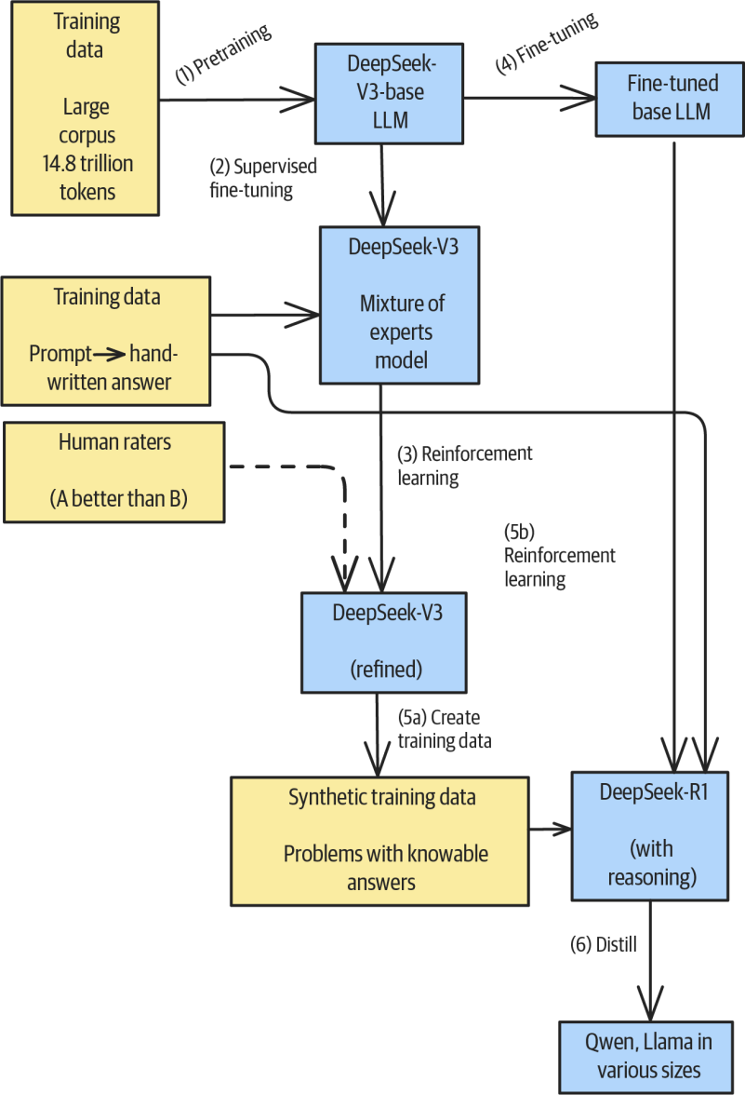
Foundational Models [1]
Mixture of experts (MoE) model: an optimization that allows models to have a large number of parameters while activating only a fraction of them for each token.

Slide 6
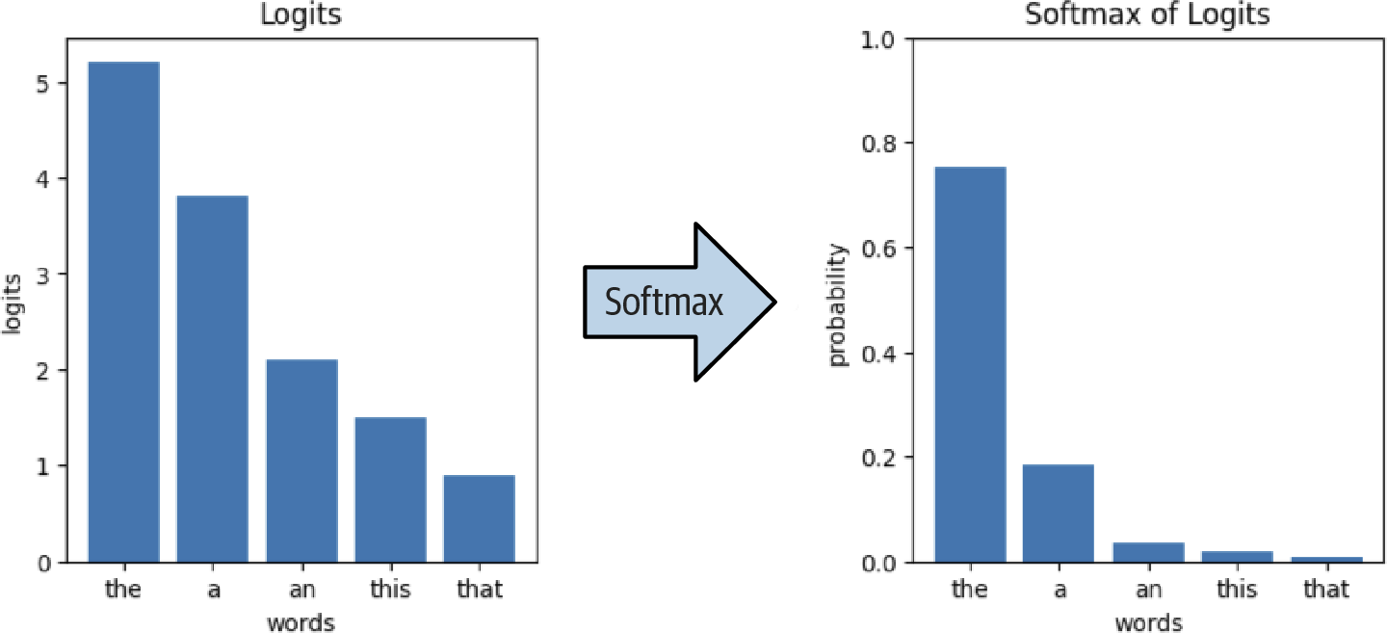
Logits
Logits are the raw, unnormalized outputs from a language model’s final layer before they’re converted into probabilities.
Logits represent the model’s assessment of how likely each token in its vocabulary is to be the next token in a sequence.
The softmax of the logits gives you the probability of various continuations.

Slide 7


Slide 8
Agent Harness
https://devblogs.microsoft.com/agent-framework/the-microsoft-agent-framework-harness-is-now-released/
https://github.com/microsoft/agent-framework/tree/main/dotnet/samples/02-agents/Harness
https://github.com/microsoft/agent-framework/tree/main/python/samples/02-agents/harness

Slide 10
Generate embeddings
https://qdrant.tech/documentation/cloud/inference/
Qdrant Cloud can also generate embeddings through Cloud Inference.

Slide 11

Thank You & See You Again

